Slide 1
Testing throughout the software life cycle

Slide 2
Models
Waterfall Model
V-Mode Model
Interative Development Model
Incremental Model
Rapid Application Development Model
Agile Model

Slide 3
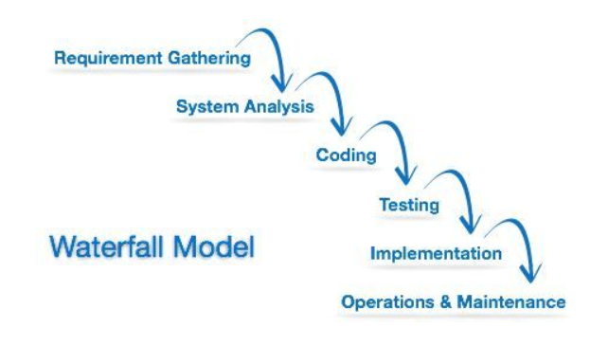
Waterfall Model

Slide 4
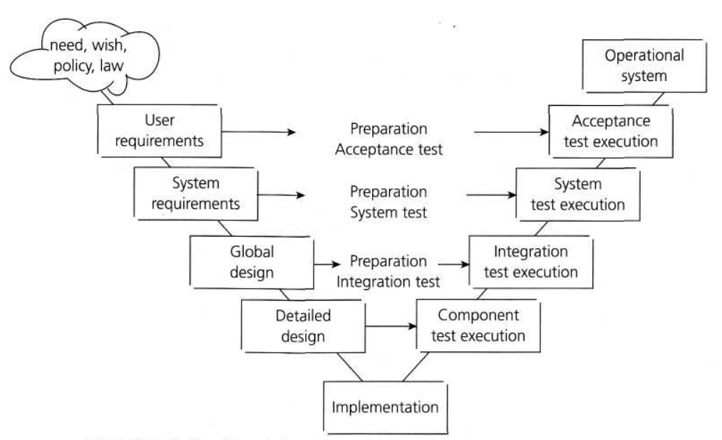
V-Mode Model

Slide 5
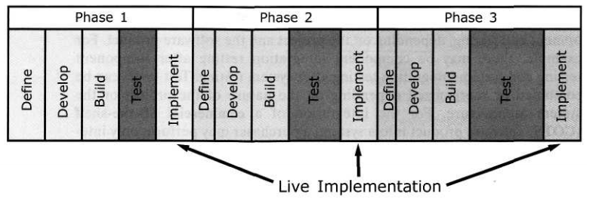
Interative Development Model

Slide 6
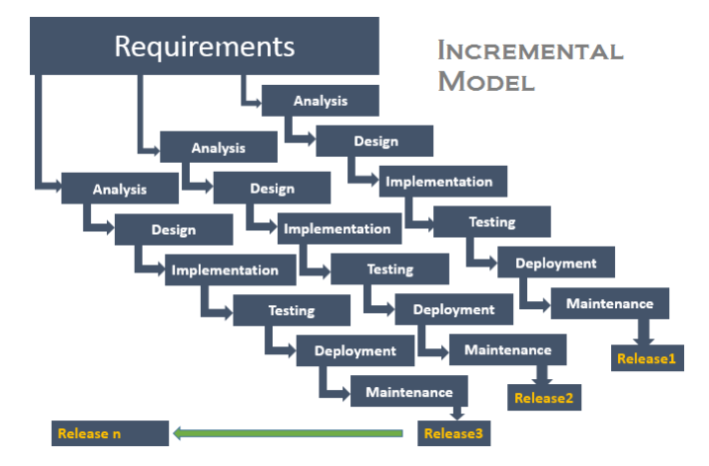
Incremental Model

Slide 7
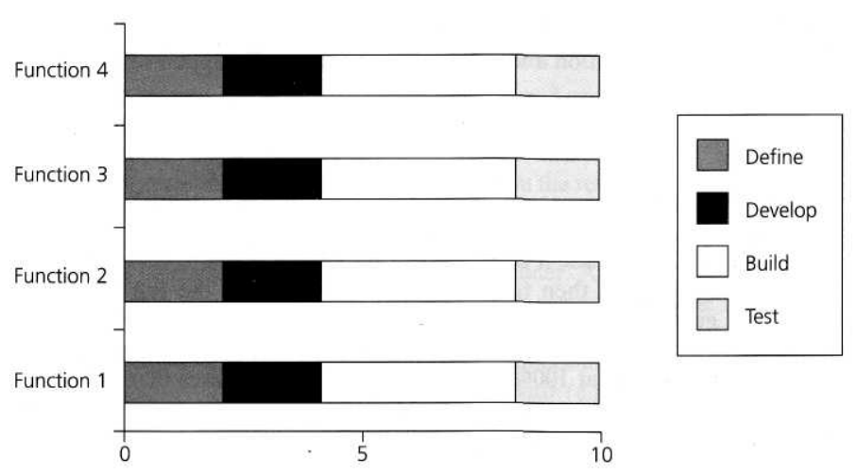
Rapid Application Development Model

Slide 8
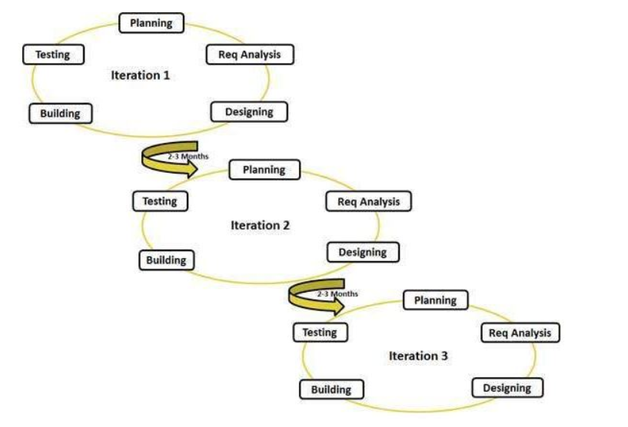
Agile Model

